Slide 1
Mini Project Presentation
Diabetic Retinopathy Using CNN
Presented by:-
Anmol Khandelwal
Aryan Mangla
Devashish Singh

Slide 2
AIM
To Identify Diabetic Retinopathy Using the Retinal Images in an efficient manner.
CNN is one of the feature used to identify the Diabetic Retinopathy
OBJECTIVE
The objective of this project is to implement an automated detection of diabetic retinopathy (DR) using digital fundus images.
By using Image Processing to extract and detect the features such as blood vessels and textures which will determine two general classifications: normal or abnormal (DR) eye

Slide 3
What is Diabetic Retinopathy?
Diabetic retinopathy is caused by damage to the blood vessels in the tissue at the back of the eye (retina).
Poorly controlled blood sugar is a risk factor.
Early symptoms include floaters, blurriness, dark areas of
vision and difficulty perceiving colours. Blindness can
occur.

Slide 4
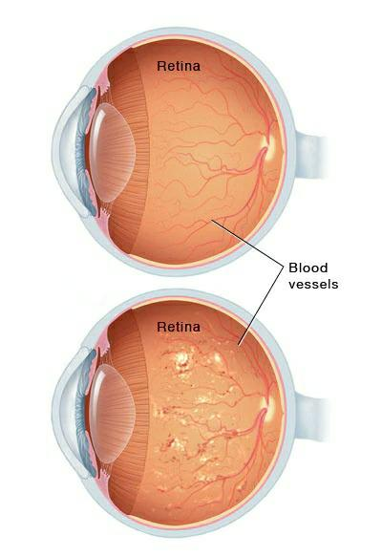
Types Of Diabetic Retinopathy
Early diabetic retinopathy
Advanced diabetic retinopathy

Slide 5

Normal Vision Defective Vision

Slide 6
Libraries used
Pandas
Numpy
Matplot lib
Keras
SKlearn

Slide 7
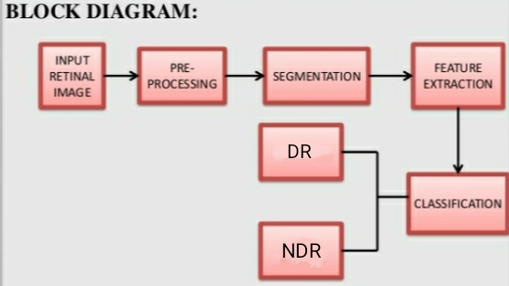

Slide 8
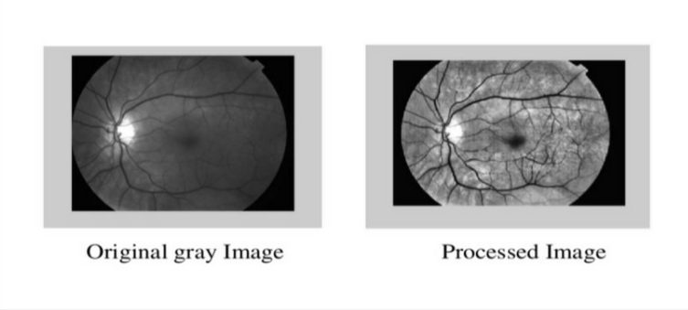
Purpose Of Image Processing
Fundus Photography is performed by a fundus camera, which basically consists of a specialized low power microscope with an attached camera.
The Back Portion of the Interior of the eyeball, visible through the pupil.
The retinal fundus images are commonly used for detection and analysis of diabetic retinopathy disease.
The low contrast retinal-image intensity increased and a number of edge pixels were extracted.

Slide 9
Key Points
• User will input retinal blood vessel image.
• Algorithm is applied to extract vessels from image.
• Filtering method are used to remove noise from image
• Local entropy threshold and alternative sequential filter methodology is implemented to extract.
• Image pre-processing steps are applied to get accurate result.
• System will remove all unwanted objects from image.
• System will apply algorithm to extract retinal blood vessels.
• Finally system will give diabetic retinopathy accuracy.

Slide 10
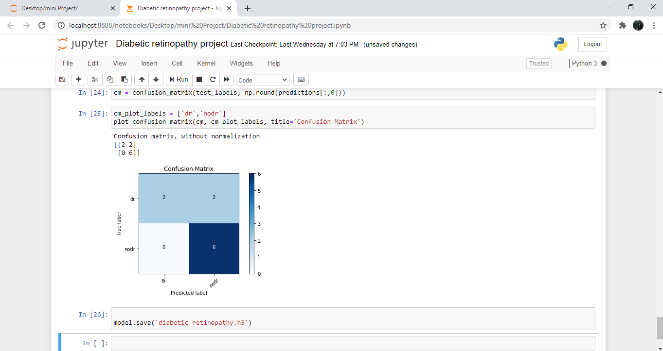
Execution Of Final Output

Slide 11
Conclusion
By using 50 images as training input and same number of images for test we got these results on classification In this way we got descent results for our analysis. In Above slide we can see that it gives around 80%accuracy in the results.
Future Work
Future Work In future in order to improve efficiency and better results I would like to employ below modifications in the project such as :-
• Increase size of test and training data set
• To use better morphological analysis algorithms to get clearer features.

Slide 12


